Slide 1
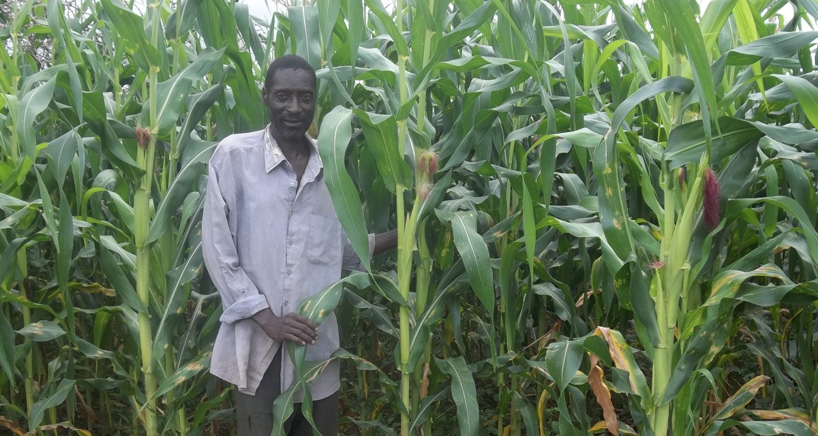
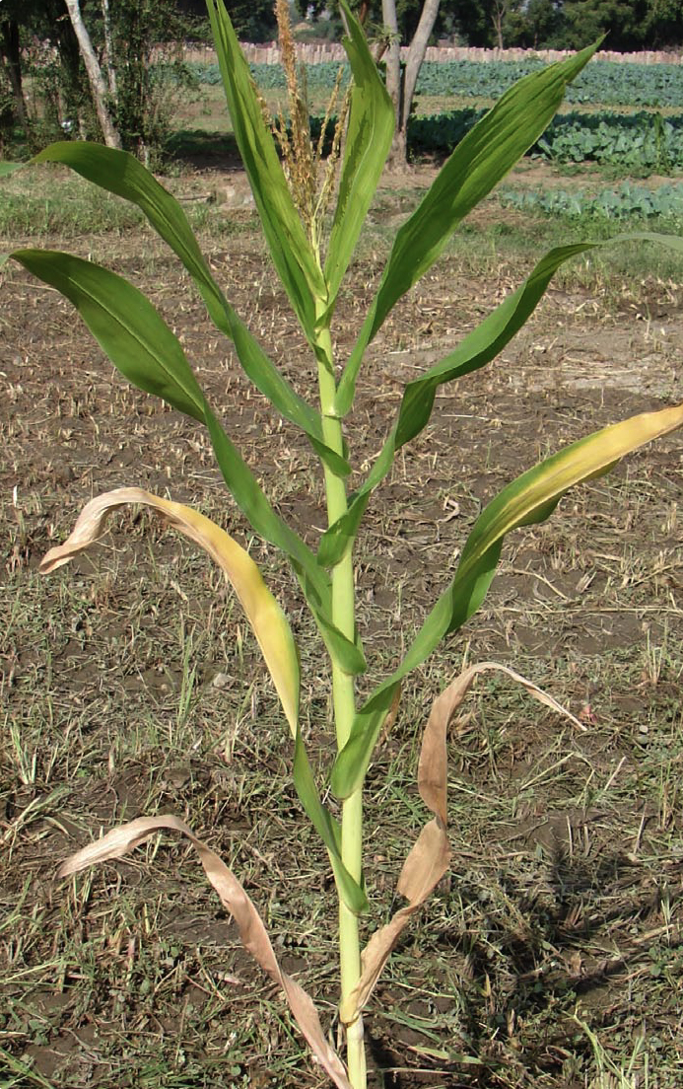
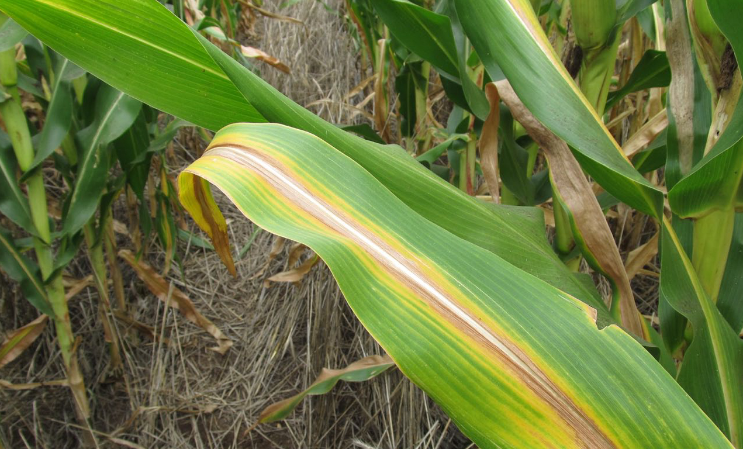
Key considerations when
designing your poster:
Only promote technologies that are proven and cost effective with a realistic suggestions of what return on investment can be achieved. State the likely improvements, not the best possible outcome.
Make sure that the information provided is ‘actionable’
Colours:
We showed some materials to a group of people in Mozambique – they described the design as funeral colours. In this template we have supplied options for using bright bold colours.
Should you need to select an alternative colour then consider using bold brights rather than pastel shades.
Text & Language:
Think about the size of the text (point size) and the function of the print – generally older people and people with lower literacy like larger print.
These templates use Arial and Arial bold. Avoid adding in other fonts as it can complicate the the piece and dilute your message.
Think about the hierarchy of messages, so use one clear headline to attract attention to your subject matter then organise the information with sub headings, bullet points.
Adopt plain language, a literary style that is easy-to-read and matches the reading skill of the audience . It is important to decide what farmers need to know – not show them how much we know. Look at everything you have written and ask yourself –what do I expect a farmer to do with information.
Think what do farmers need to know?
Use farmer’s jargon, not scientific language – make sure you know the terms farmers actually use
Use short words and short sentences make it easier to follow instructions
Keep in mind that children of the house may do the reading – where adult literacy is an issue – so this may influence your design or text
When you are planning your text, work out what is essential to know – and what is desirable. The most important information should come first within each paragraph or section
Farmers do not usually have standard measuring devices such as tape measures, or measuring cylinders. Instead use examples of non-conventional methods:
Body parts – hands legs
50kg fertilizer bags (the bags that the farmers actually used could contain up to 85kg of harvested maize)
Coke/Fanta crown tops, match boxes, margarine containers or water bottles
Cutlass blades or other basic farm tools farmers
Ensure that the text and images reflect the differences in the way men and women work
Important! Test your drafts with the target audience.
Images:
Ensure that images reinforce all key processes that are recommended – images help lock in meaning for people who struggle to read.
Getting the right photo for material can be hard. Photographs taken on a farm are much better than photos taken at research trials at research stations.
Clear comparisons – e.g. with improved seed and without, with organic material and without shown in photographs will be very persuasive.
This is where your main heading
goes. Try to keep it brief and make
the text as large as it can be to fit
the available space in bold.
healthy maize, better harvest
This is your sub heading. This is
slightly smaller than the main
heading, and not as bold.
nitrogen
Main text content of the poster.
Use clear paragraphs and bulleted
lists and headings to ensure messages are easy to digest.
Space for an image here. This
image should portray the overall
subject content of the poster.
Images of people with the subject
matter are more engaging and will
help pull attention to the poster.
Role of nitrogen in maize
Makes plants grow strong and healthy
Helps plants mature quickly
Helps cobs grow larger
Symptoms of nitrogen deficiency
Short plants
Pale green or yellow leaves
Leaves at the bottom of the plant turn yellow along the middle, and die from the tip.
To add nitrogen, use fertilizers such as
Urea
Calcium Ammonium Nitrate (CAN)
Diammonium phosphate
NPK
Extra space here for close up images
if required.
Extra space for summary information.
For better maize yields, apply the right type and amount of fertilizer,
at the right time and in the right place.
Extra space for partnership message.
Working in partnership to create down-to-earth messages on integrated soil management.
Space here for disclaimer/regulation information. And contact details.
Issues by IPNI for smallholder farers in sub-Saharan Africa-August 2013; based on the 4 ‘rights’ of sustainable nutrient management.
For more information, contact your extension officer or: International Plant Nutrition Institute (IPNI)
Email: snjoroge@ipni.net
Space here for logos.

Slide 2
Main headline here
Sub heading here
General information here:
Bullets if required
Disclaimer, regulation information here
Contact details

