Slide 1
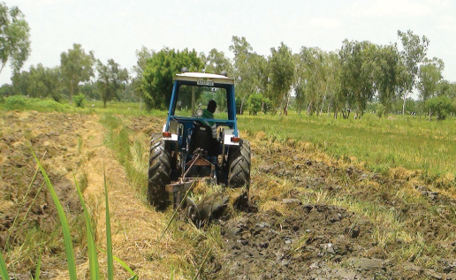
Grow better rice
Key considerations when producing your calendar:
Make sure that the information provided is ‘actionable’
Colours:
We showed some materials to a group of people in Mozambique – they described the design as funeral colours. In this template we have supplied options for using bright bold colours.
Should you need to select an alternative colour then consider using bold brights rather than pastel shades.
Text & Language:
Think about the size of the text (point size) and the function of the print – generally older people and people with lower literacy like larger print.
These templates use Arial and Arial bold. Avoid adding in other fonts as it can complicate the the piece and dilute your message.
Think about the hierarchy of messages, so use one clear headline to attract attention to your subject matter then organise the information with sub headings, bullet points.
Adopt plain language, a literary style that is easy-to-read and matches the reading skill of the audience . It is important to decide what farmers need to know – not show them how much we know. Look at everything you have written and ask yourself –what do I expect a farmer to do with information.
Think what do farmers need to know?
Use farmer’s jargon, not scientific language – make sure you know the terms farmers actually use
Use short words and short sentences make it easier to follow instructions
Keep in mind that children of the house may do the reading – where adult literacy is an issue – so this may influence your design or text
When you are planning your text, work out what is essential to know – and what is desirable. The most important information should come first within each paragraph or section
Farmers do not usually have standard measuring devices such as tape measures, or measuring cylinders. Instead use examples of non-conventional methods:
Ensure that the text and images reflect the differences in the way men and women work
Images:
Ensure that images reinforce all key processes that are recommended – images help lock in meaning for people who struggle to read.
Getting the right photo for material can be hard. Photographs taken on a farm are much better than photos taken at research trials at research stations.
Clear comparisons – e.g. with improved seed and without, with organic material and without shown in photographs will be very persuasive.
Tips for farmers in Northern Ghana
Page title/Main Heading
Sub/heading.
JANUARY 2017
-
-
-
-
-
-
1
2
3
4
5
6
7
8
9
10
11
12
13
14
15
Space for photograph/image of activity
16
17
18
19
20
21
22
23
24
25
26
27
28
29
Fully customisable calendar. Simply add in Month, Year and then dates under each day.
30
31
-
-
-
-
-
FEBRUARY 201
-
-
1
2
3
4
5
6
7
8
9
10
11
12
LAND PREPARATION
13
14
15
16
17
18
19
20
21
22
23
24
25
26
Enter information here
Plough, harrow and level your field for a uniform seed bed to help spread water throughout the field.
Plant rice on a fairly flat field with loamy soil. Loamy soil retains moisture well and has organic matter.
Avoid burning to clear the field. Burning kills soil life and destroys some nutrients.
Bund your field to conserve water and to control diseases like blasts and brown spot.
27
28
-
-
-
-
-
-
-
-
-
-
-
-
Enter contact details here
For more information, contact: The Director, CSIR-SARI (e): sknutsugah@hotmail.com or your nearest agricultural extension of officer
Add logos in here.

