Slide 1
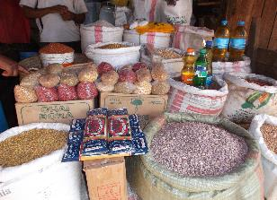
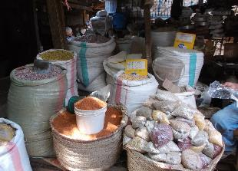
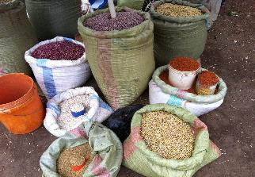
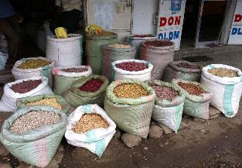
N2Africa Tanzania
Market Research on dried beans in Arusha, Moshi and Hai districts: A summary
Verena Mitschke

Slide 2
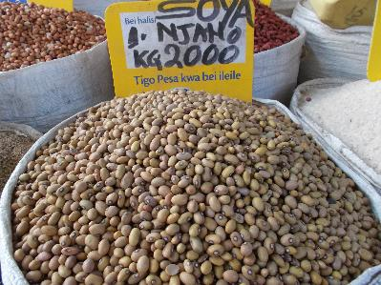
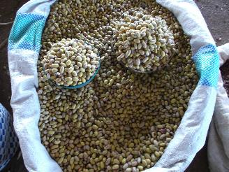
Soya Njano
Soya Njano is the most preferred bean as it cooks faster, contains less acid and tastes sweeter compared to other available beans.
Soya Njano can be found in a round and an oval shape. However, they are being sold all together, even though people could fetch a higher price when sorting them.

Slide 3
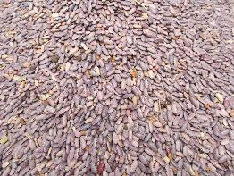
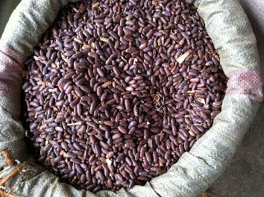
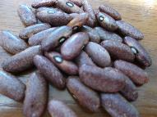
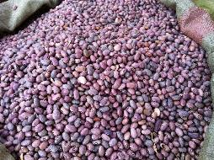
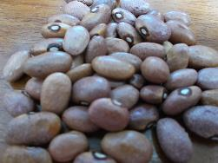
Soya Kijivu (left) and Soya Ndefu (right) (Military Soya, Combat, Iringa)

Slide 4
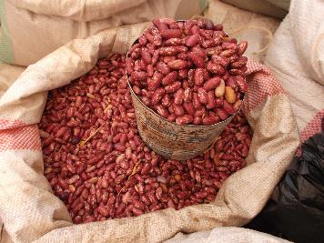
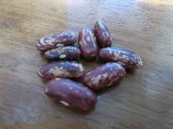
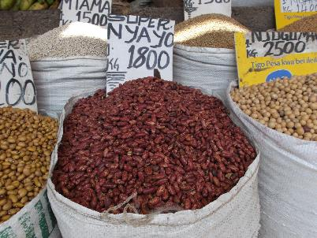
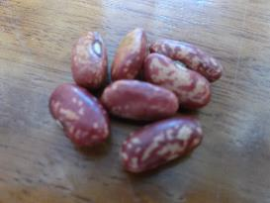
Nyayo (Rose Coco)
People at the markets usually sell Lyamungu 85 and Lyamungo 90 (improved bean vaieties) under the name of Nyayo or Rose Coco.

Slide 5
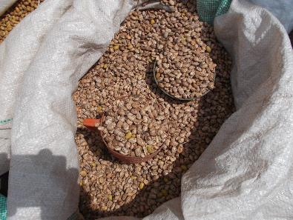
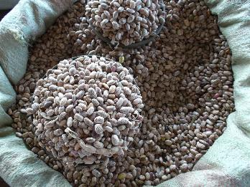
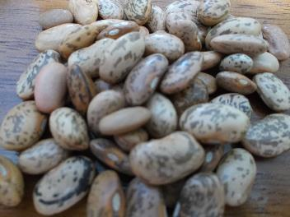
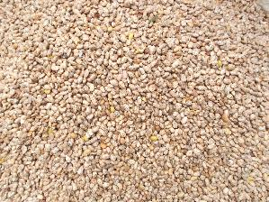
Kariassi

Slide 6
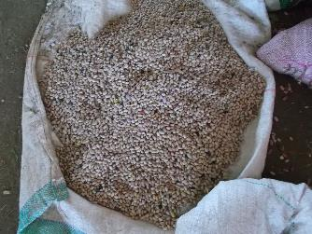
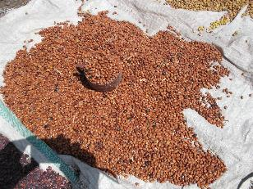
Bukoba (Biskuti, brown and white)
Bukoba normally has a brownish color (left), but changes color when stored for a long time (right).
Bukoba can also be found in white.

Slide 7
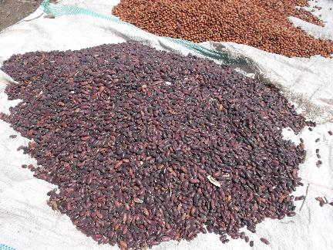
Canadian Wonder (Canada)
Canadian Wonder has a dark red color and a long oval shape.

Slide 8
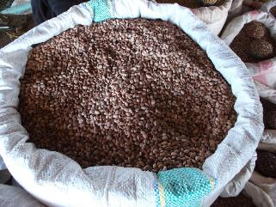
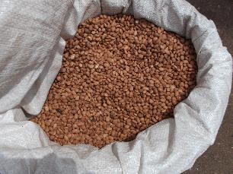
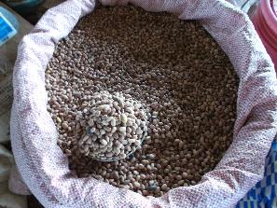
Kanamna (Mrondo, brown and white)
Kanamna can be found in brown and white, it is slightly smaller and not as round as Bukoba.

Slide 9
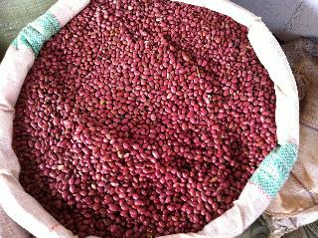
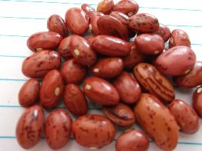
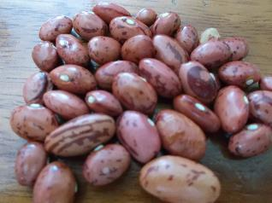
Karanga
Karanga is red, mottled and has a round shape.

Slide 10
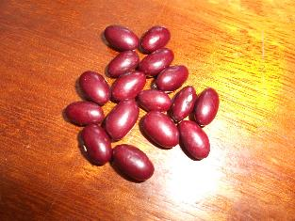
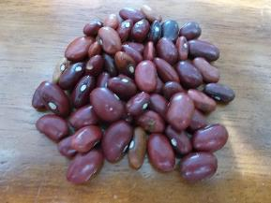
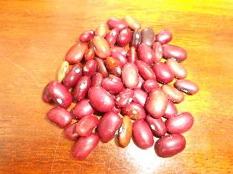
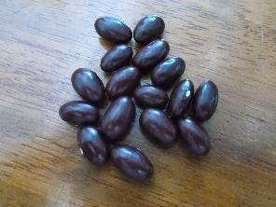
Masai Red and Kichumbe
Here I am not 100% sure which one of these is Kichumbe and Masai Red, but I think that Kichumbe is slightly smaller and not as round as Masai Red.
Also, I only saw Kichumbe being sold in the markets.

